Slide 1
Business Analytics
using the R language

Slide 2
Learning Objectives
how to input data in R using various ways
how to check for correct data input
how to use special packages for fast data input
how to input data from statistical file formats
how to input data from databases
how to input data from web (web scraping)

Slide 3
What will you learn from this lesson
data input from various kinds of format
efficient data input via various packages
sql to R
web scraping
piping in R
using json in R

Slide 4
Environment
ls() -lists objects
rm()-removes an object
gc() -does garbage collection and frees up memory

Slide 5
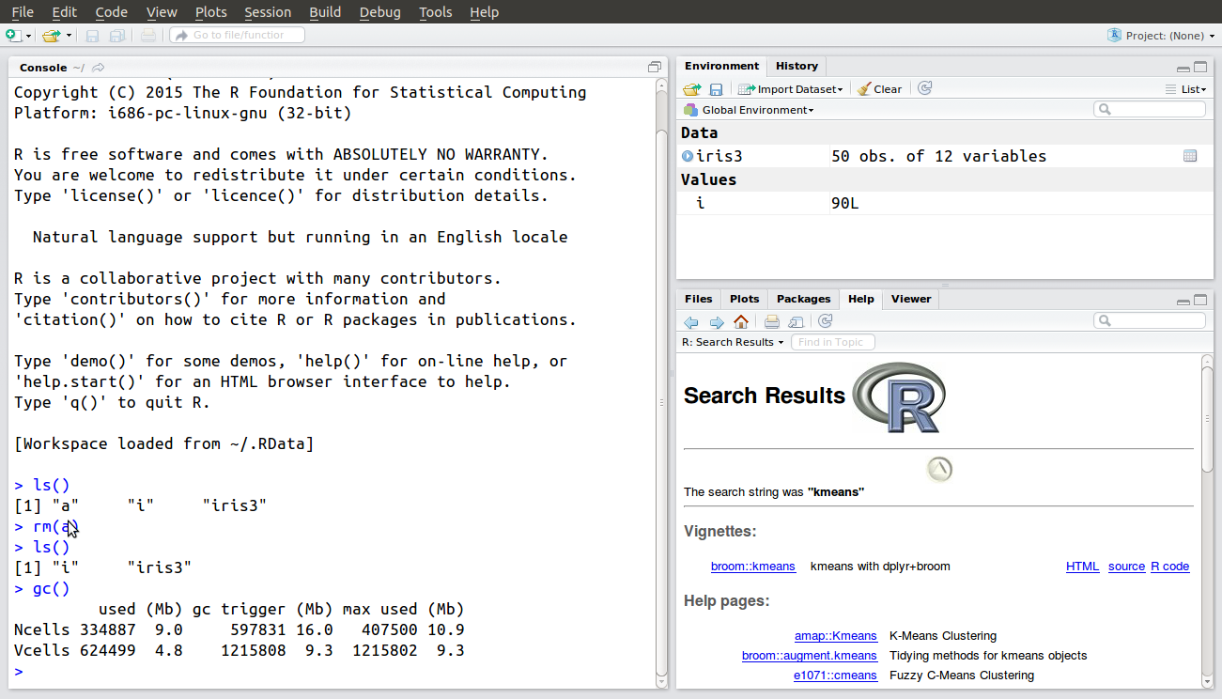
Environment
ls() -lists objects
rm()-removes an object
gc() -does garbage collection and frees up memory

Slide 6
Environment
ls() -lists objects
rm()-removes an object
gc() -does garbage collection and frees up memory

Slide 7
File System
getwd()- get working directory
setwd()- set or change working directory
dir() - lists files in working directory

Slide 8
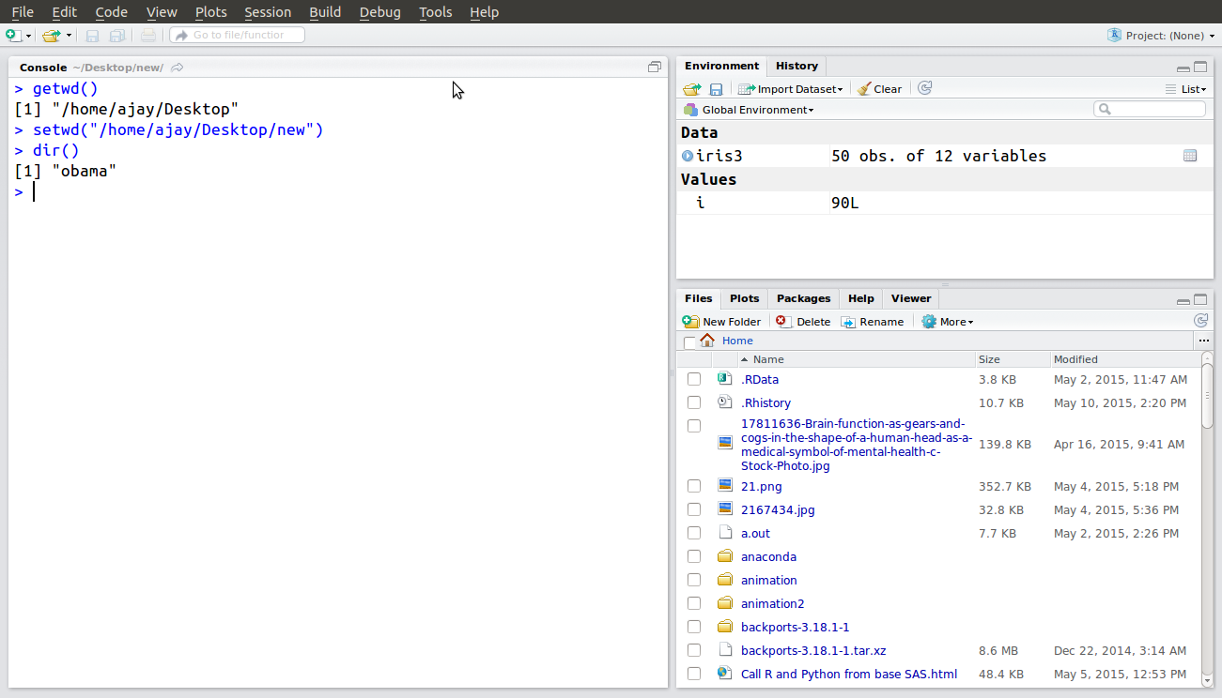
File System
getwd()- get working directory
setwd()- set or change working directory
dir() - lists files in working directory

Slide 9
File System
getwd()- get working directory
setwd()- set or change working directory
dir() - lists files in working directory

Slide 10
File System
getwd()- get working directory
setwd()- set or change working directory
dir() - lists files in working directory

Slide 11
Assigning
objectname=read.csv(filepath,parameters)
OR
objectname<-read.csv(filepath,parameters)

Slide 12
Data Input
read.table() or read.csv()
read.spss()
read.sas7bdat()

Slide 13
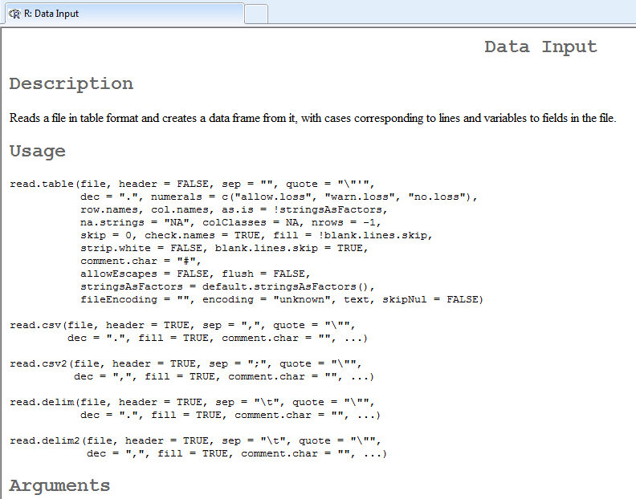
read.table()
https://stat.ethz.ch/R-manual/R-devel/library/utils/html/read.table.html

Slide 14
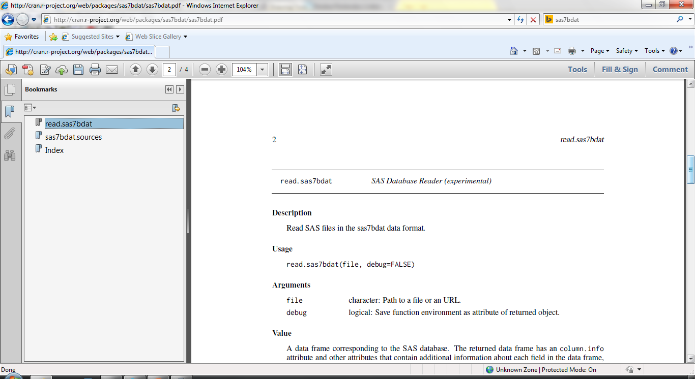
Statistical formats
read.spss from foreign package
read.sas7bdat from sas7bdat package

Slide 15
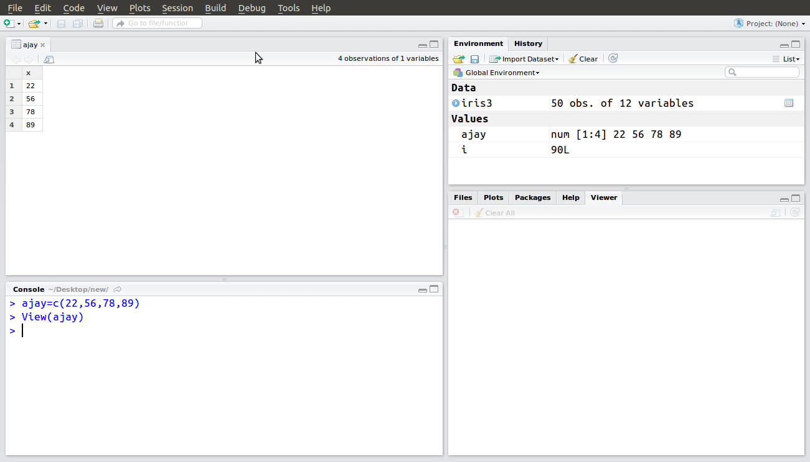
Manual Entry

Slide 16
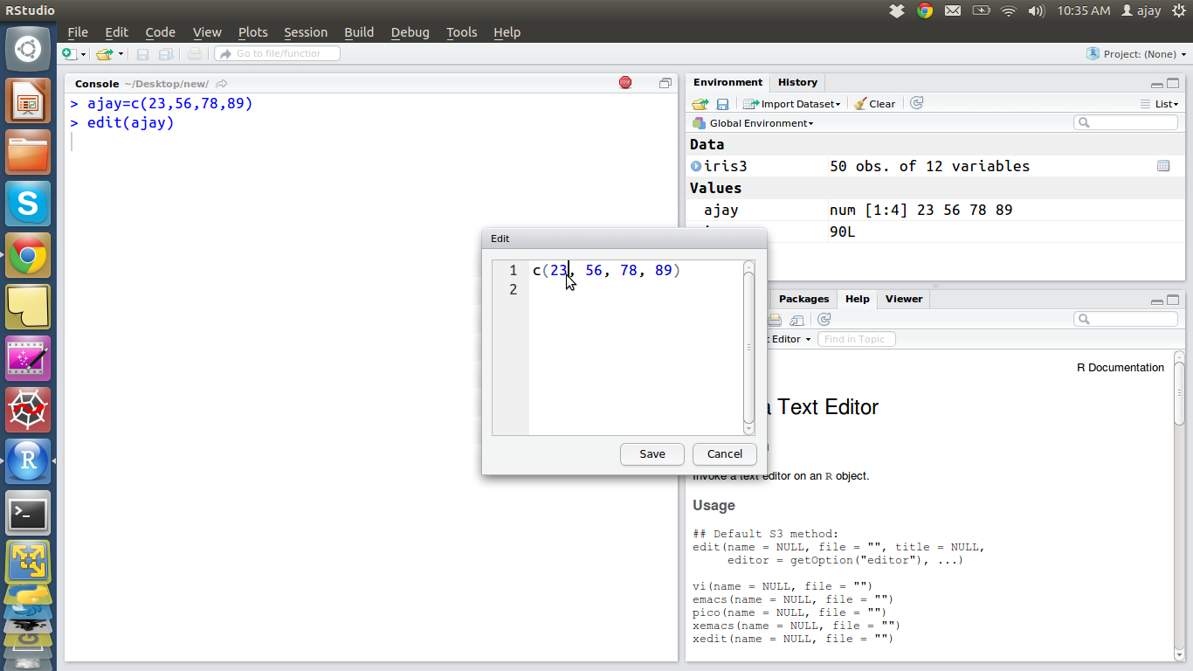
Manual Editing

Slide 17
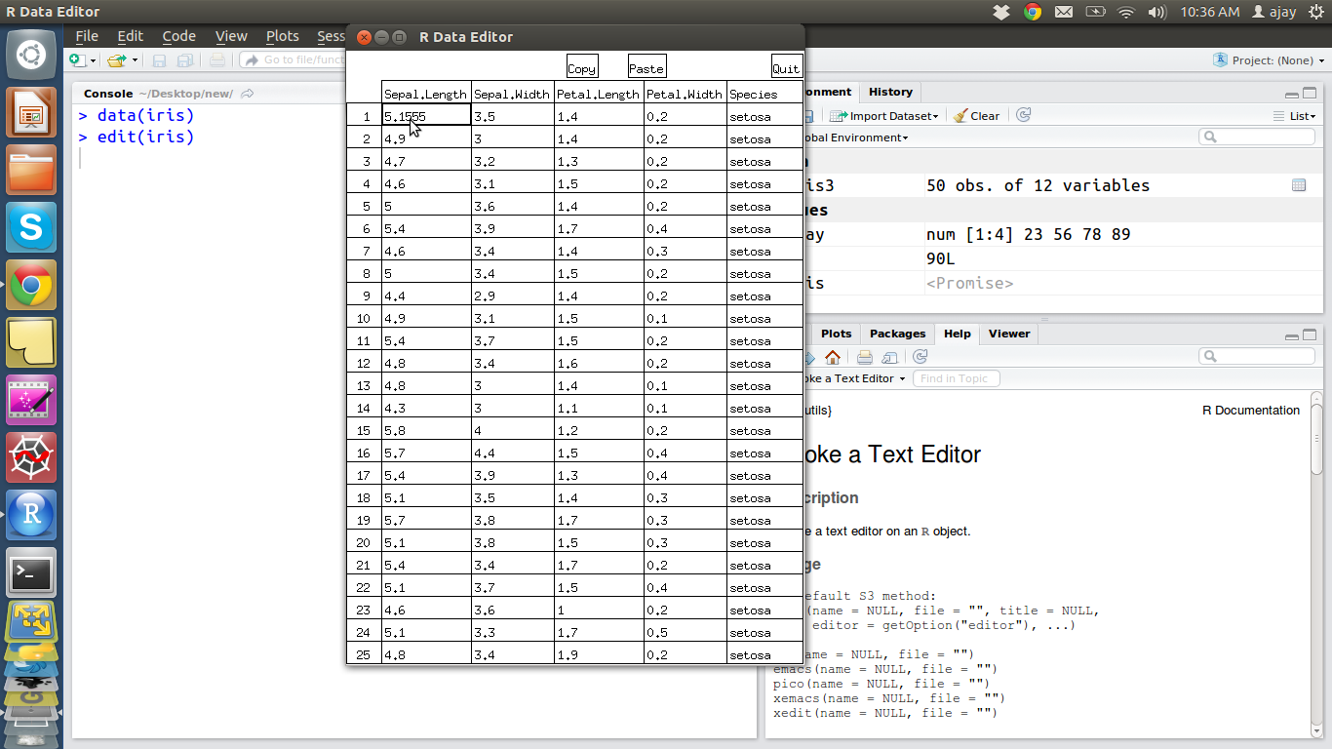
Manual Editing

Slide 18
readr from Hadley
The goal of readr is to provide a fast and friendly way to read tabular data into R. The most important functions are:
Read delimited files: read_delim(), read_csv(), read_tsv(), read_csv2().
Read fixed width files: read_fwf(), read_table().
Read lines: read_lines().
Read whole file: read_file().
Re-parse existing data frame: type_convert().
https://github.com/hadley/readr

Slide 19
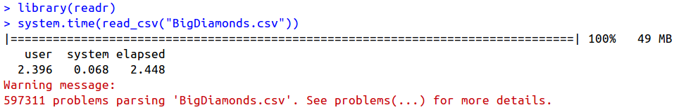
readr from Hadley
Source Data - https://bit.ly/dsdata
https://github.com/hadley/readr

Slide 20
readxl from Hadley
Readxl supports both the legacy .xls format and the modern xml-based .xlsx format. .xlssupport is made possible the with libxls C library, which abstracts away many of the complexities of the underlying binary format. To parse .xlsx, we use the RapidXML C++ library.
read_excel("my-old-spreadsheet.xls") read_excel("my-new-spreadsheet.xlsx") read_excel("my-spreadsheet.xls", sheet = "data") read_excel("my-spreadsheet.xls", sheet = 2) read_excel("my-spreadsheet.xls", na = "NA")
https://github.com/hadley/readxl

Slide 21
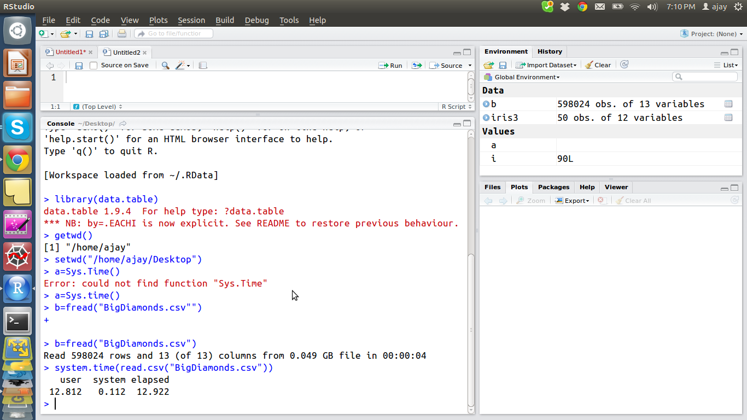
data.table
fread is the fastest way to read data

Slide 22
data.table
fread is the fastest way to read data

Slide 23
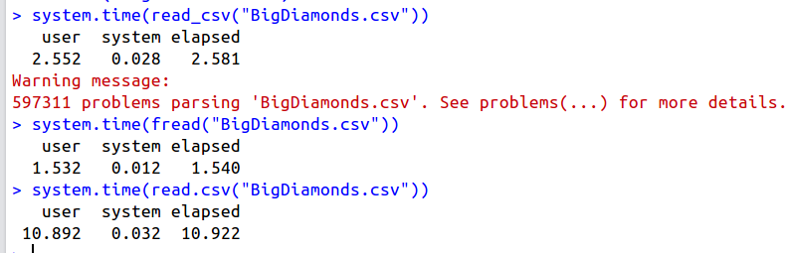
data.table
fread is the fastest way to read data

Slide 24
Some learnings
Multiple packages can do the same thing faster or slower in R
Knowing the right package is the essential difference as a data scientist
Putting code within system.time() helps measure speed
also see http://adv-r.had.co.nz/Profiling.html for advanced ways to spped up code

Slide 25
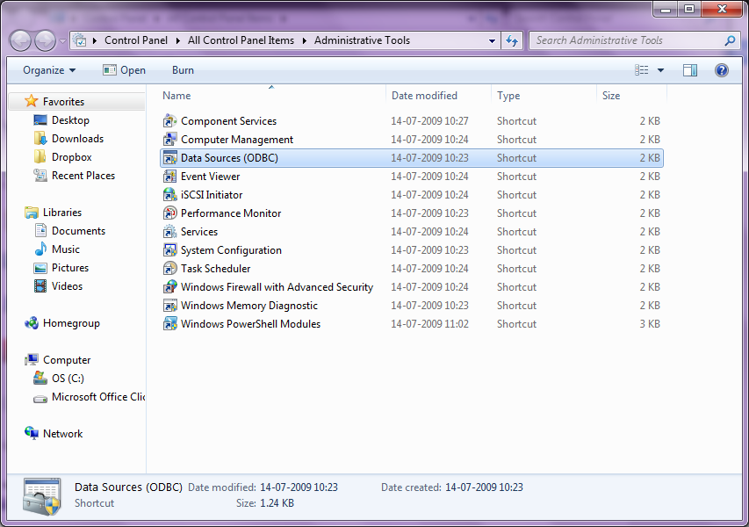
Creating DSN

Slide 26
Creating DSN (in Windows)
A Data Source Name (DSN) is the logical name that is used by Open Database Connectivity (ODBC) to refer to the drive and other information that is required to access data. The name is use by Internet Information Services for a connection to an ODBC data source, such as a Microsoft SQL Server database.
https://support.microsoft.com/en-us/kb/kbview/300596

Slide 27
Creating DSN (in Windows)
Click Start, point to Control Panel, double-click Administrative Tools, and then double-click Data Sources(ODBC).
Click the System DSN tab, and then click Add.
Click the database driver that corresponds with the database type to which you are connecting, and then click Finish.
Type the data source name. Make sure that you choose a name that you can remember. You will need to use this name later.
Click Select.
Click the correct database, and then click OK.
Click OK, and then click OK.
https://support.microsoft.com/en-us/kb/kbview/300596

Slide 28
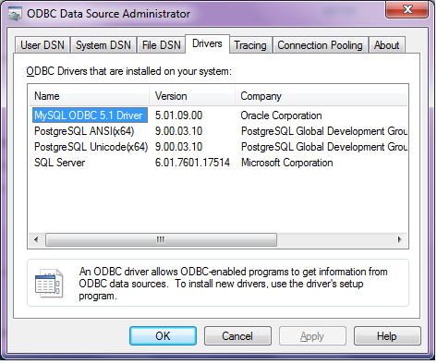
Creating DSN

Slide 29
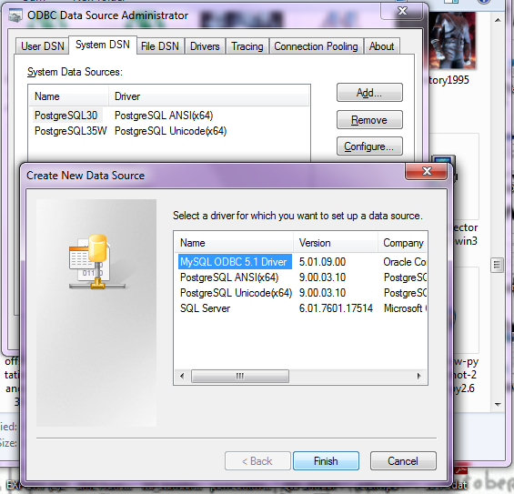
Creating DSN

Slide 30
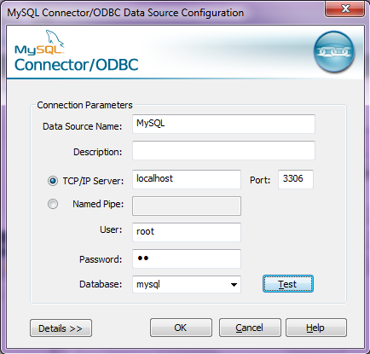
Creating DSN

Slide 31
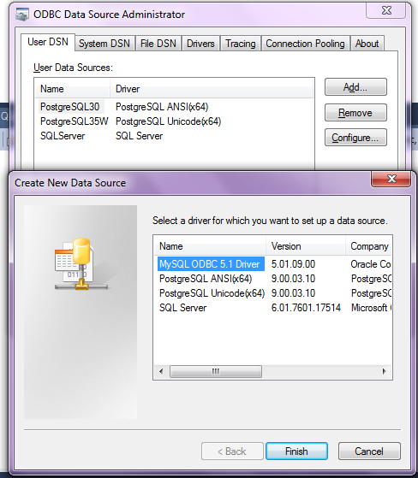
Creating DSN

Slide 32
RODBC
> library(RODBC)
> odbcDataSources()
> ajay=odbcConnect(“MySQL”,uid=”root”,pwd=”XX”)
> ajay
> sqlTables(ajay)
>tested=sqlFetch(ajay,”host”)

Slide 33
From Databases
The RODBC package provides access to databases through an ODBC interface.
The primary functions are
odbcConnect(dsn, uid="", pwd="") Open a connection to an ODBC database
sqlFetch(channel, sqltable) Read a table from an ODBC database into a data frame
Hint- a good site to revise R http://www.statmethods.net

Slide 34
sqlite
http://cran.r-project.org/web/packages/RSQLite/RSQLite.pdf embeds the SQLite database engine in R and provides an interface compliant with the DBI package.
SQLite is a software library that implements a self-contained, serverless, zero-configuration, transactional SQL database engine.
SQLite is the most widely deployed database engine in the world
library(RSQLite)
con <- dbConnect("SQLite", dbname = "sample_db")
# read csv file into sql database
dbWriteTable(con, name="sample_data", value="sample_data.csv", row.names=FALSE, header=TRUE, sep = ",")
http://cran.r-project.org/web/packages/sqldf/index.html Manipulate R data frames using SQL
read.csv.sql in the sqldf package imports data into a temporary SQLite database and then reads it into R.

Slide 35
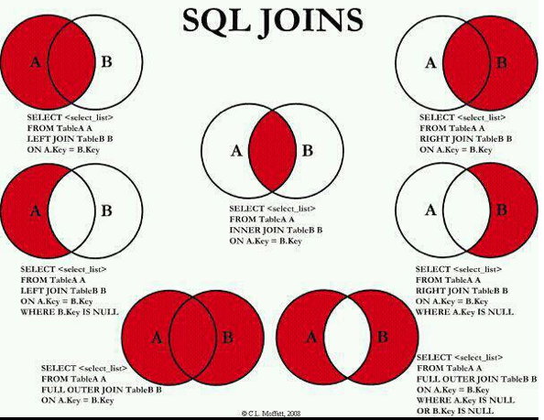
A Detour to SQL

Slide 36
RMySQL
install.packages("RMySQL")
library(RMySQL)
mydb = dbConnect(MySQL(), user='user', password='password', dbname='database_name', host='host')
dbListTables(mydb)
dbListFields(mydb, 'some_table')
dbSendQuery(mydb, 'drop table if exists some_table, some_other_table')
dbWriteTable(mydb, name='table_name', value=data.frame.name)

Slide 37
Other databases
Teradata https://github.com/Teradata/teradataR
PostgreSQL http://cran.r-project.org/web/packages/RPostgreSQL/
MongoDB http://cran.r-project.org/web/packages/mongolite/index.html
couchDB http://cran.r-project.org/web/packages/couchDB/index.html
MonetDB http://cran.r-project.org/web/packages/MonetDB.R/index.html

Slide 38
Other data sources
Cassandra with R http://cran.r-project.org/web/packages/RCassandra/RCassandra.pdf
Neo4j with R
http://things-about-r.tumblr.com/post/47392314578/venue-recommendation-a-simple-use-case-connecting-r
R with Hadoop Stack https://github.com/RevolutionAnalytics/RHadoop/wiki
NEW! ravro - read and write files in avro format
plyrmr - higher level plyr-like data processing for structured data, powered by rmr
rmr - functions providing Hadoop MapReduce functionality in R
rhdfs - functions providing file management of the HDFS from within R
rhbase - functions providing database management for the HBase distributed database from within R
https://amplab-extras.github.io/SparkR-pkg/ SparkR is an R package to use Spark from R.

Slide 39
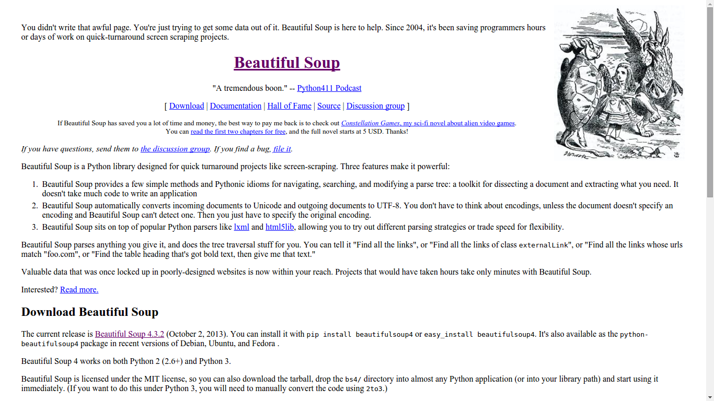
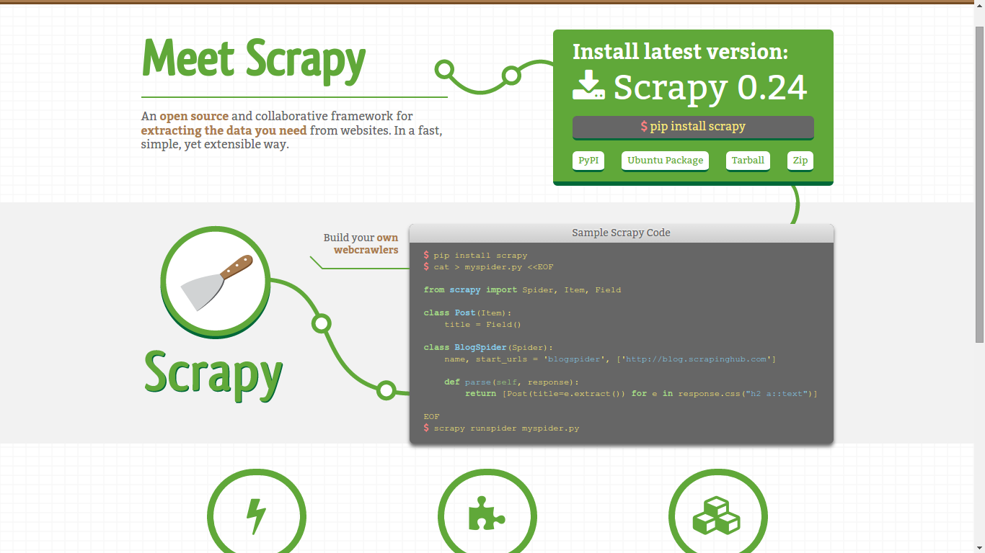
Web Scraping
Web scraping (web harvesting or web data extraction) is a computer software technique of extracting information from websites.
example - python (scrapy and beautiful soup)

Slide 40
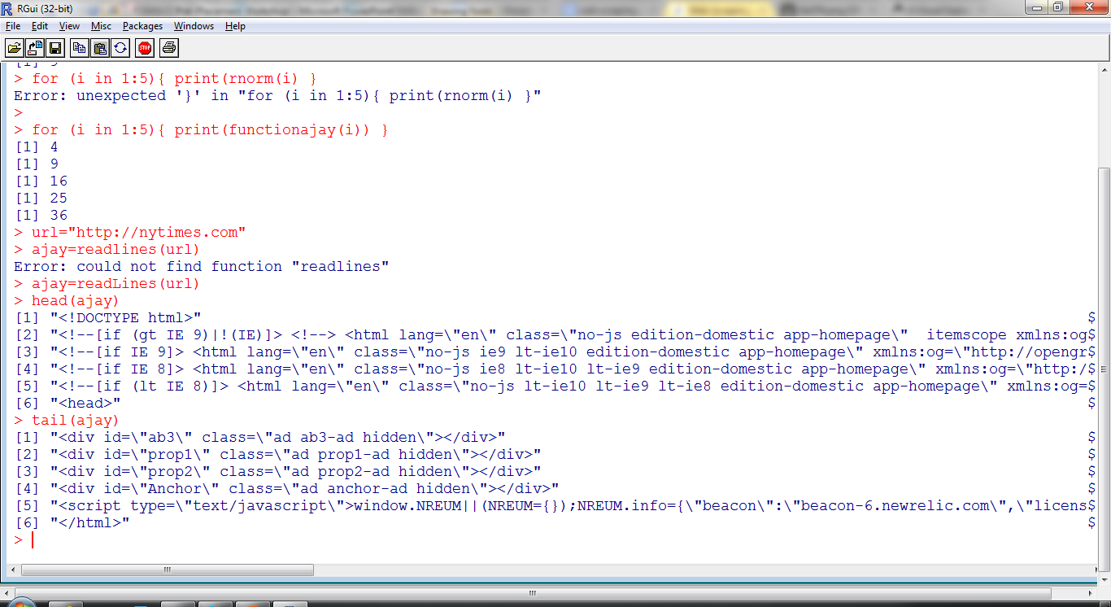
Web Scraping
Hint : R is case sensitive
readlines is not the same as readLines
readlines
Hint : Use head() and tail() to inspect objects
Other packages are XML and Curl
Case Study- http://decisionstats.com/2013/04/14/using-r-for-cricket-analysis-rstats/

Slide 41
curl
cURL is a computer software project providing a library and command-line tool for transferring data using various protocols. The cURL project produces two products, libcurl and cURL.
The RCurl package is an R-interface to the libcurl library that provides HTTP facilities. This allows us to download files from Web servers, post forms, use HTTPS (the secure HTTP), use persistent connections, upload files, use binary content, handle redirects, password authentication, etc.
The primary top-level entry points are
getURL()
getURLContent()
getForm()
postForm()
http://www.omegahat.org/RCurl/RCurlJSS.pdf

Slide 42
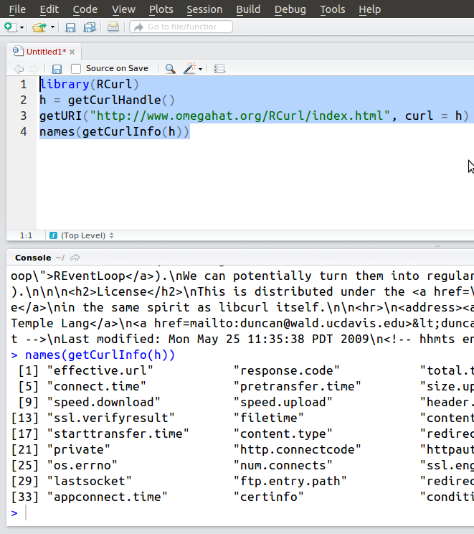
Rcurl

Slide 43
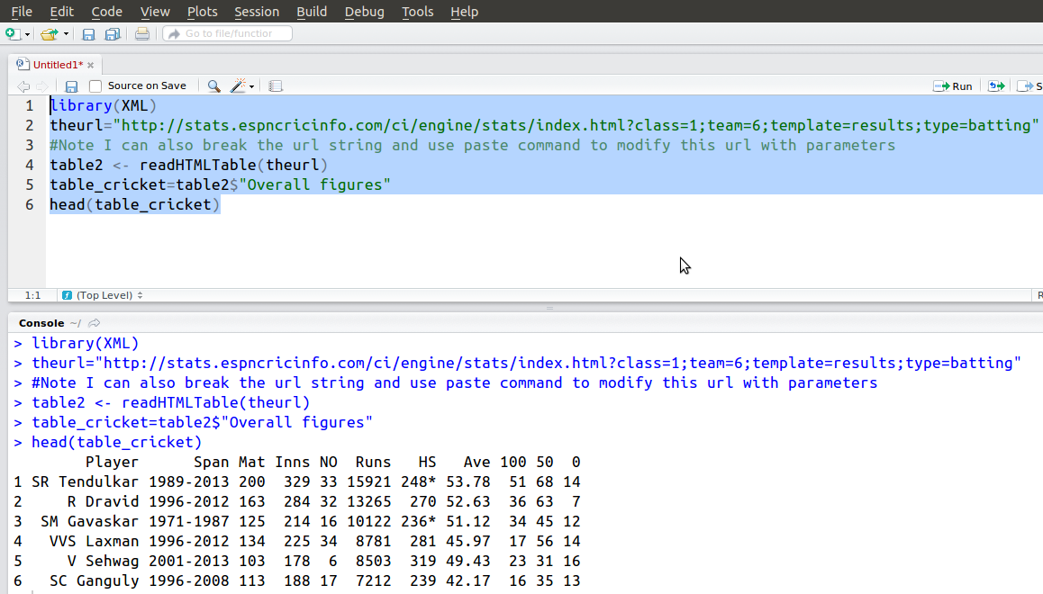
XML

Slide 44
a note on piping using magrittr
This stylistic option has several advantages:
1. Reduced requirements of nested parenthesizes
2. Order of functional operations now read from left to right
3. Organizational style of the code may be improved
The library uses a operator %>% which basically tells R to take the value of that which is to the left and pass it to the right as an argument
http://www.econometricsbysimulation.com/2014/07/more-readable-code-with-pipes-in-r.html
1 + 8 %>% sqrt # Returns 3.828427 # Rather than (1 + 8) %>% sqrt # [1] 3

Slide 45
a note on piping using magrittr
let (|>) x f = f x.
some_value |> some_function other_value
babynames %>% filter(name %>% substr(1, 3) %>% equals("Ste")) %>% group_by(year, sex) %>% summarize(total = sum(n)) %>% qplot(year, total, color = sex, data = ., geom = "line") %>% add(ggtitle('Names starting with "Ste"')) %>% print
INTERPRET
1. take the baby data, then 2. filter it such that the name sub-string from character 1 to 3 equals "Ste", then 3. group it by year and sex, then 4. summarize it by computing total sum for each group, then 5. plot the resuls, coloring by sex, then 6. add a title, then 7. print it to the canvas.

Slide 46
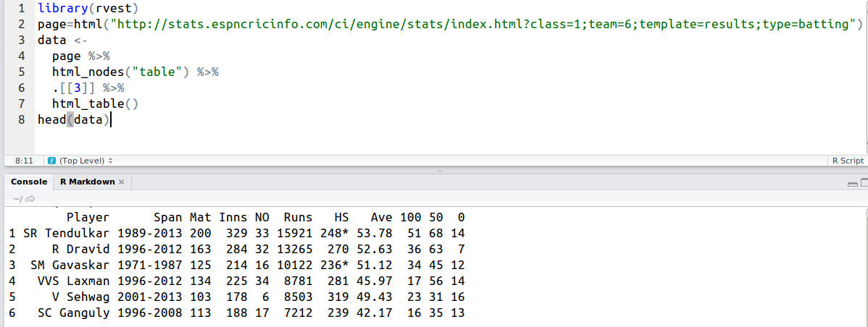
rvest by Hadley Wickham

Slide 47
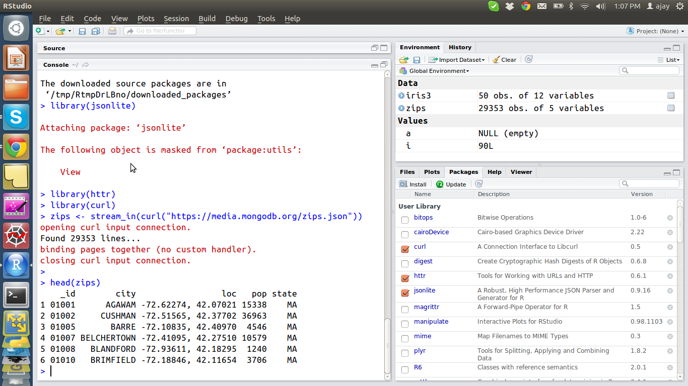
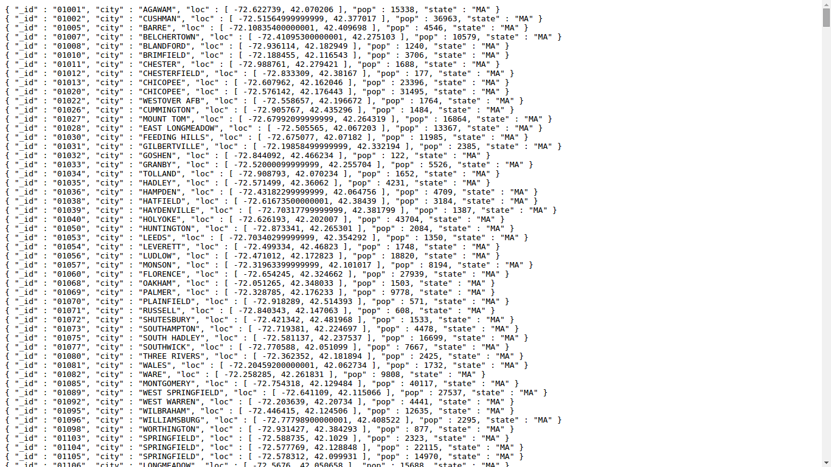
json format
jsonlite for json data
http://arxiv.org/abs/1403.2805

Slide 48
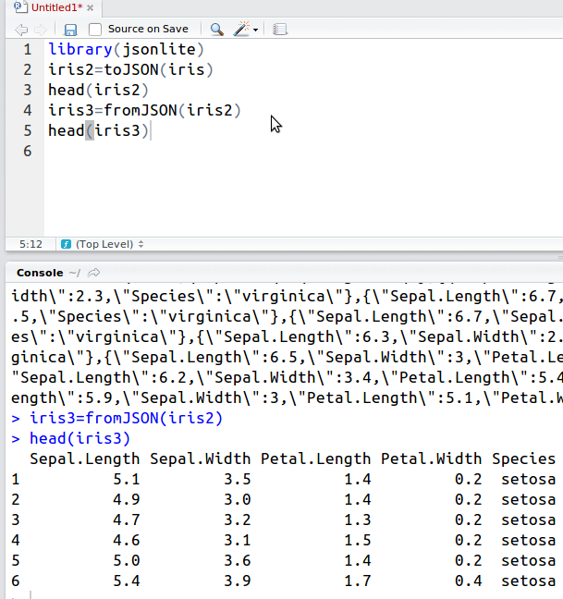
json format
jsonlite for json data
http://arxiv.org/abs/1403.2805

Slide 49
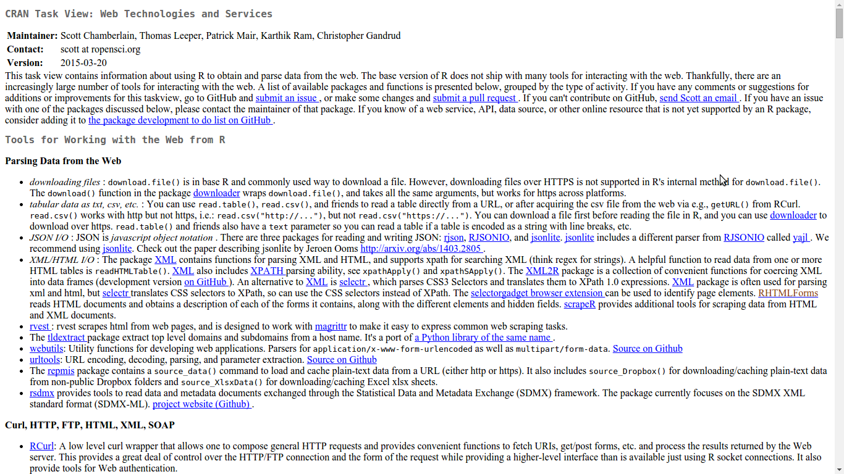
Using APIs for data
https://ropensci.org/

Slide 50
ff package
http://cran.r-project.org/web/packages/ff/index.html
The ff package provides data structures that are stored on disk but behave (almost) as if they were in RAM by transparently mapping only a section (pagesize) in main memory - the effective virtual memory consumption per ff object.
http://cran.r-project.org/web/packages/ffbase/index.html
Basic (statistical) functionality for package ff
Example- http://www.bnosac.be/index.php/blog/22-if-you-are-into-large-data-and-work-a-lot-package-ff
> require(ffbase)
> hhp <- read.table.ffdf(file="/home/jan/Work/RForgeBNOSAC/github/RBelgium_HeritageHealthPrize/Data/Claims.csv", FUN = "read.csv", na.strings = "")
Also see http://cran.r-project.org/web/packages/bigmemory/index.html
Create, store, access, and manipulate massive matrices. Matrices are allocated to shared memory and may use memory-mapped files. Packages biganalytics, bigtabulate, synchronicity, and bigalgebra provide advanced functionality

Slide 51
RevoScaleR package
RevoScaleR has its own file format, XDF, which is able to rapidly access data by row or by column and to read some data sequentially. XDF file data is stored in the same binary format used in memory, which eliminates the need for conversion when it is brought into memory.
http://www.revolutionanalytics.com/revolution-r-enterprise-scaler

Slide 52
rhdf5
This R/Bioconductor package provides an interface between HDF5 and R. HDF5's main features are the ability to store and access very large and/or complex datasets and a wide variety of metadata on mass storage (disk) through a completely portable file format.
http://www.bioconductor.org/packages/release/bioc/html/rhdf5.html
HDF5 is a data model, library, and file format for storing and managing data. It supports an unlimited variety of datatypes, and is designed for flexible and efficient I/O and for high volume and complex data. HDF5 is portable and is extensible, allowing applications to evolve in their use of HDF5.
https://www.hdfgroup.org/HDF5/
HDF5 simplifies the file structure to include only two major types of object:
Datasets, which are multidimensional arrays of a homogeneous type
Groups, which are container structures which can hold datasets and other groups

Slide 53
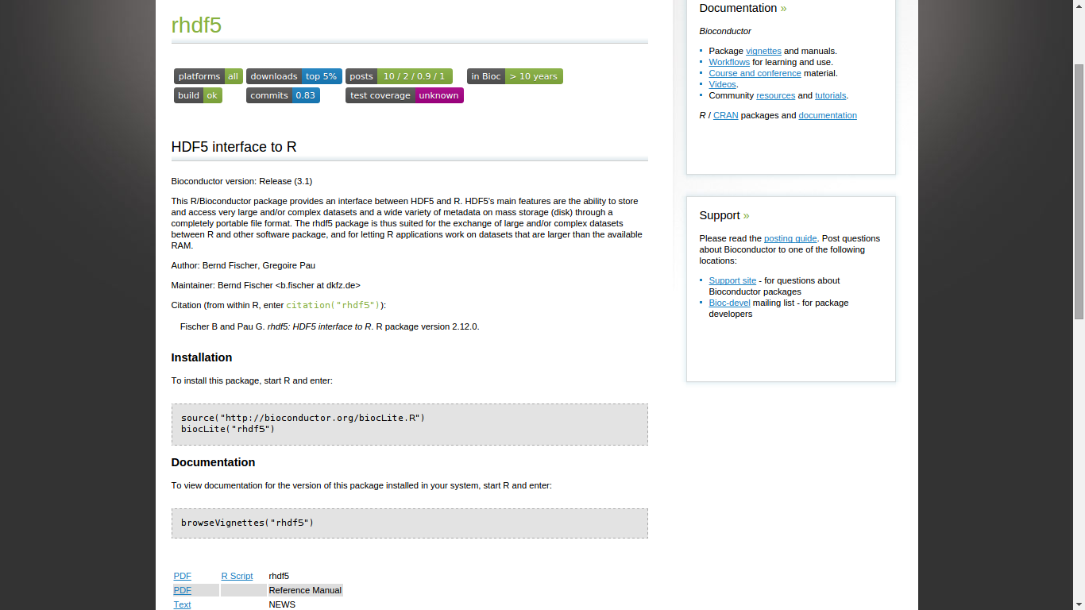
rhdf5
This R/Bioconductor package provides an interface between HDF5 and R. HDF5's main features are the ability to store and access very large and/or complex datasets and a wide variety of metadata on mass storage (disk) through a completely portable file format.
http://www.bioconductor.org/packages/release/bioc/html/rhdf5.html
HDF5 is a data model, library, and file format for storing and managing data. It supports an unlimited variety of datatypes, and is designed for flexible and efficient I/O and for high volume and complex data. HDF5 is portable and is extensible, allowing applications to evolve in their use of HDF5.
https://www.hdfgroup.org/HDF5/
HDF5 simplifies the file structure to include only two major types of object:
Datasets, which are multidimensional arrays of a homogeneous type
Groups, which are container structures which can hold datasets and other groups

Slide 54
Functions Used in this lesson
toJSON and fromJSON

Slide 55
Packages
data.table
jsonlite
rvest

Slide 56
Citations and References
M Dowle, T Short, S Lianoglou, A Srinivasan with contributions from R Saporta and E Antonyan (2014) data.table: Extension of data.frame. R package version 1.9.4. http://CRAN.R-project.org/package=data.table
Jeroen Ooms (2014). The jsonlite Package: A Practical and Consistent Mapping Between JSON Data and R Objects. arXiv:1403.2805 [stat.CO] URL http://arxiv.org/abs/1403.2805
Hadley Wickham (2015). rvest: Easily Harvest (Scrape) Web Pages. R package version 0.2.0. http://CRAN.R-project.org/package=rvest

